Slide 1
Custom Vision API
Jason Goodsell,
Software Developer,
Datacom

Slide 2
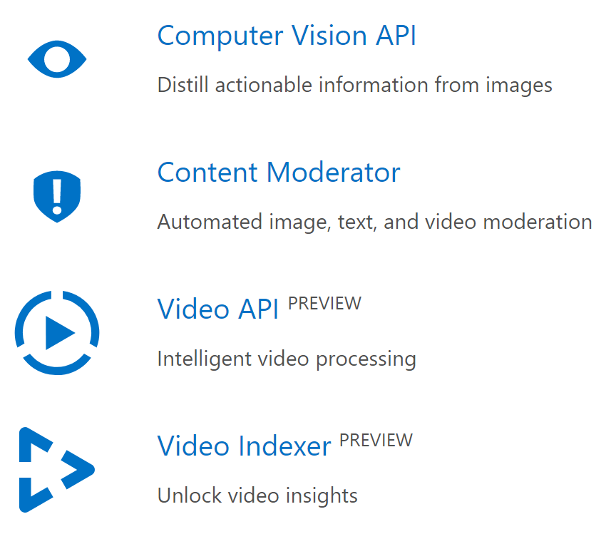
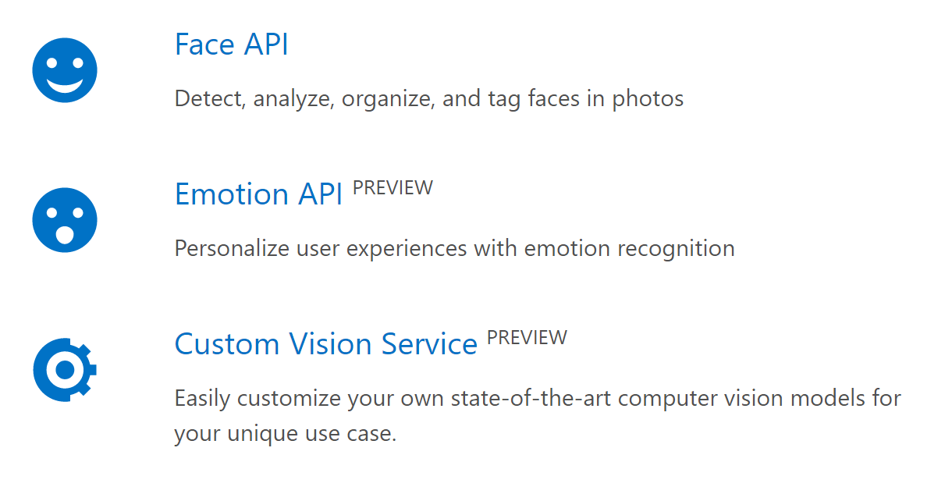
Cognitive Services

Slide 3
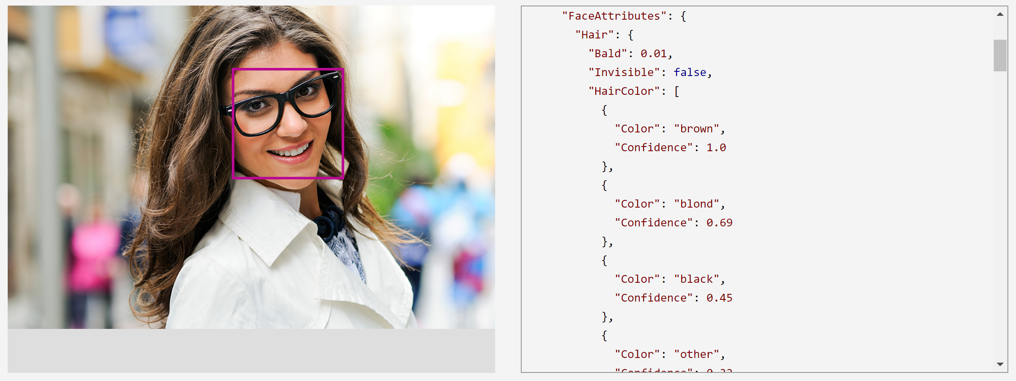
Face API

Slide 4
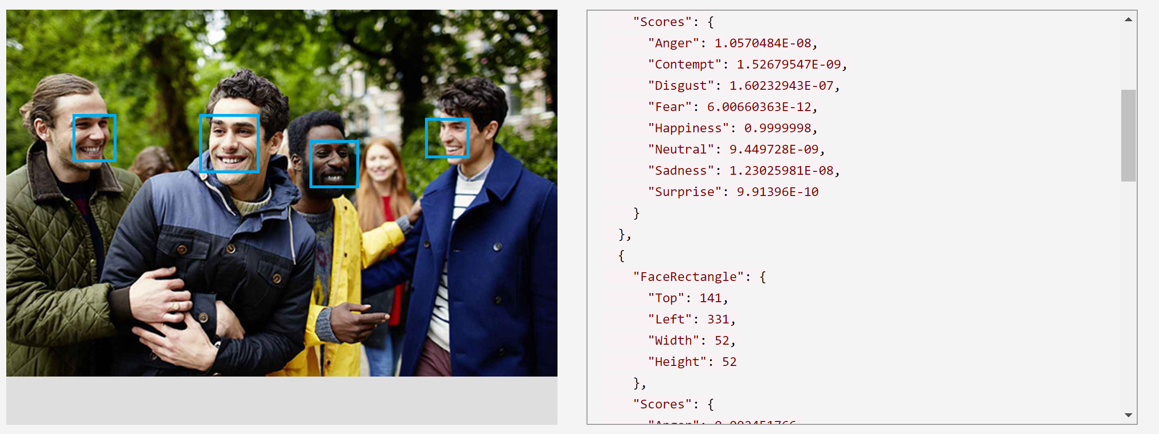
Emotion API

Slide 5
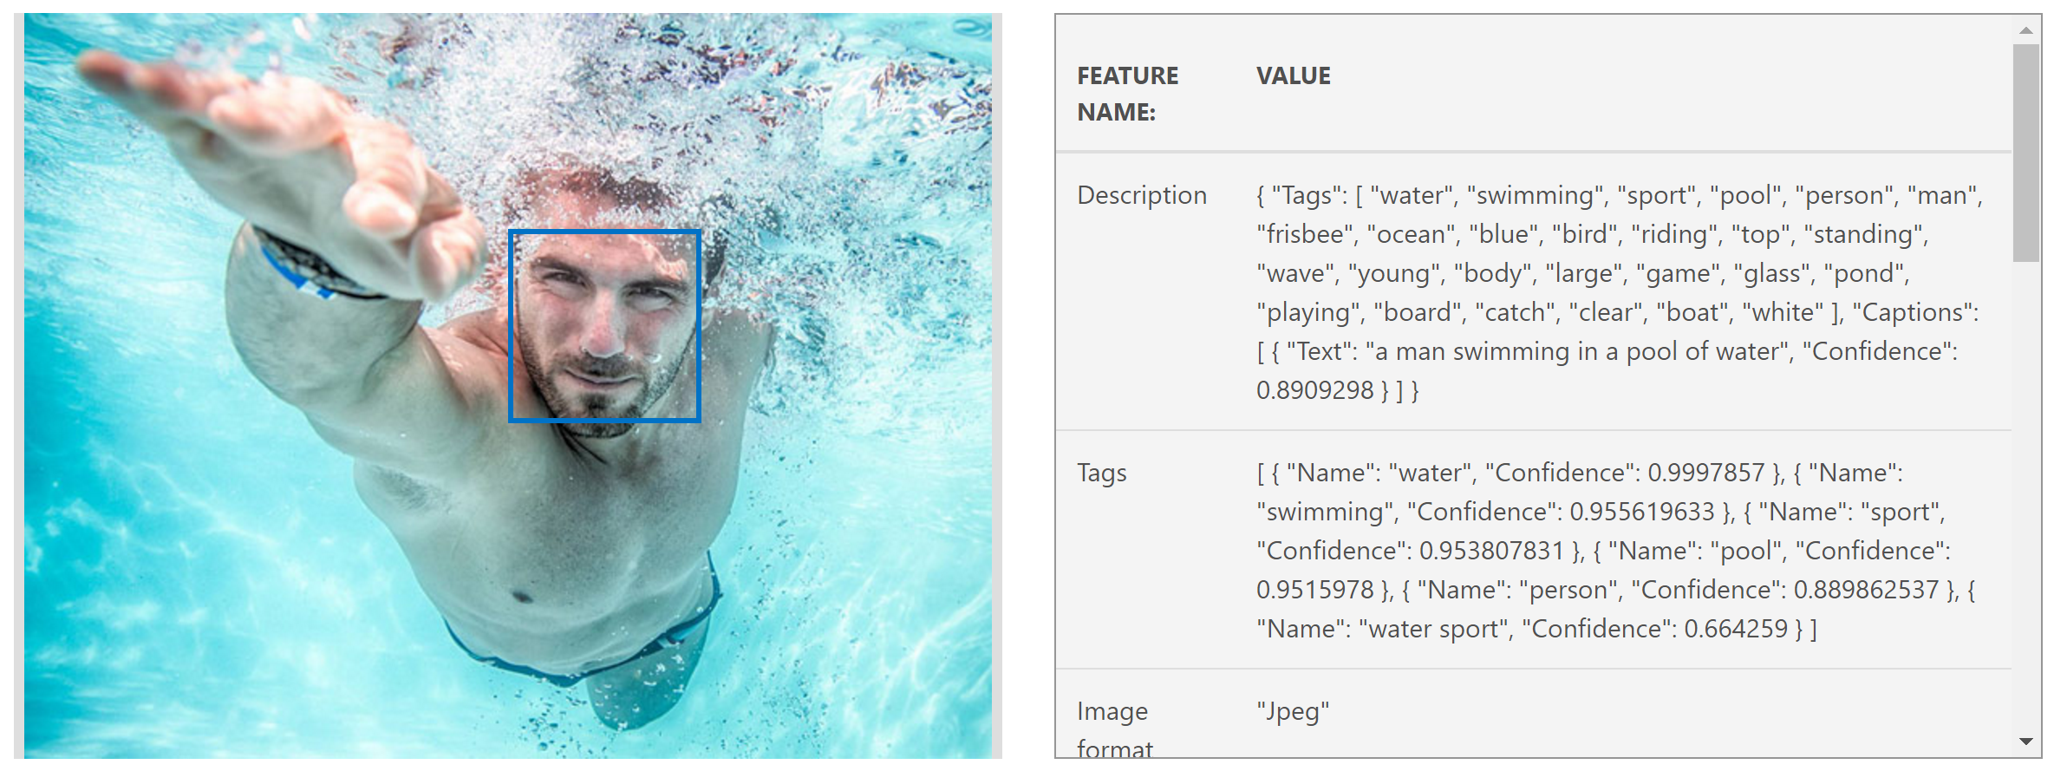
Computer Vision API

Slide 6
Custom Vision API

Slide 7
Custom Vision API
Just like the Computer Vision API
Your own data!
Continue training your model
Hosted in Azure with easy to use REST APIs for training and evaluating model

Slide 8
Thanks!

